Slide 1
Neabsco
January Advisory
Council
January 29, 2025

Slide 2
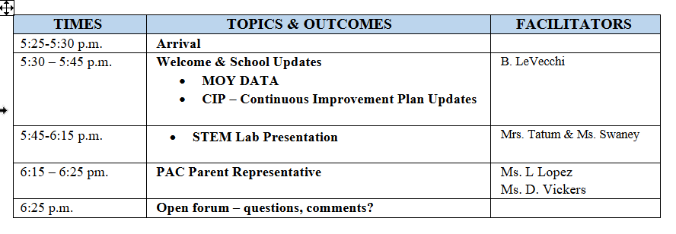
Agenda

Slide 3
Middle of the Year Data
Grades 2-5 HMH
Grades 3-5 Math VGA – Virginia Growth Assessment
VALLSS – K-3 (Code based assessments only)

Slide 4
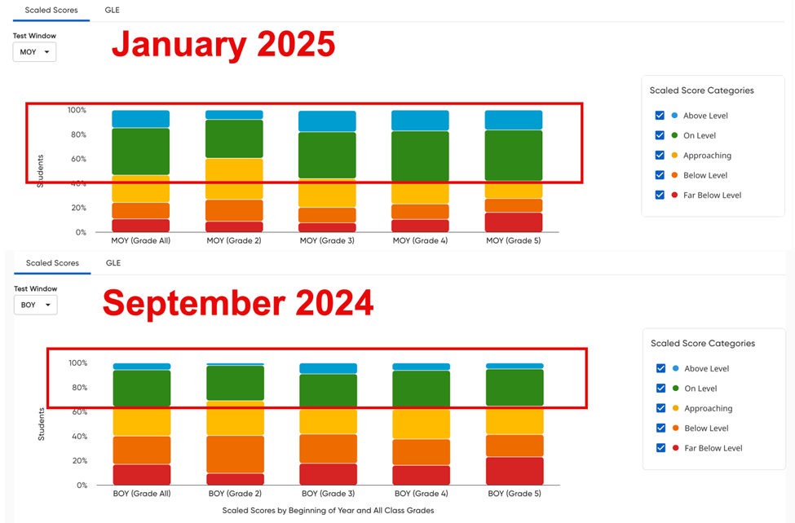

Slide 5
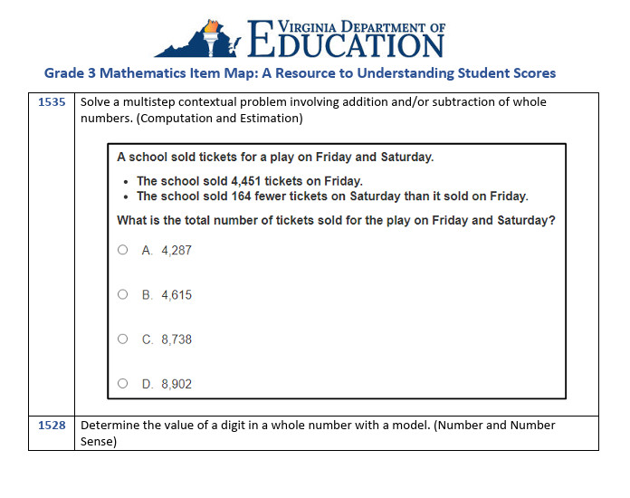

Slide 6
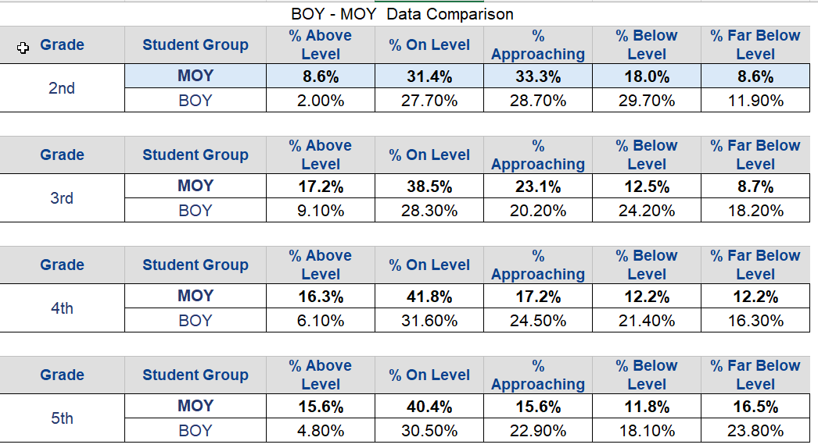
HMH Data

Slide 7
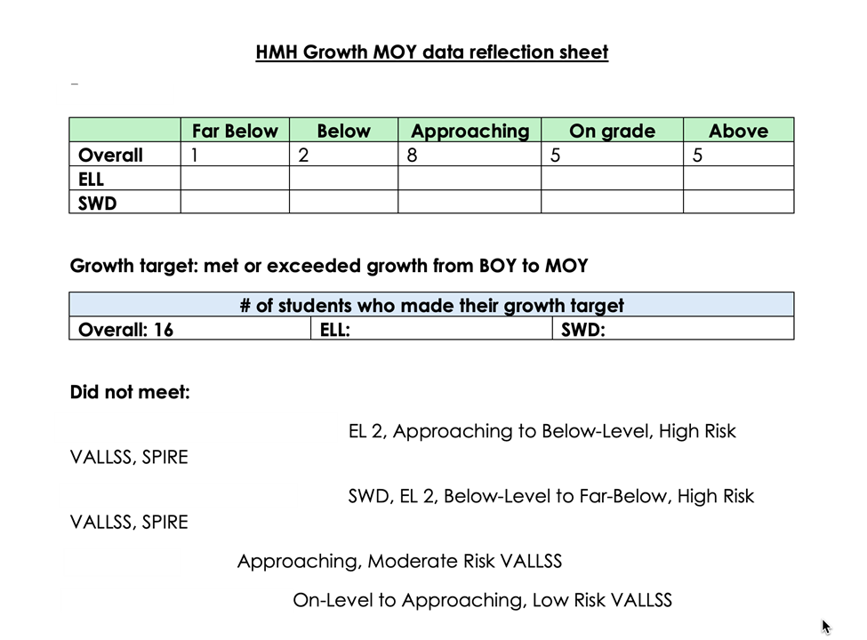
HMH Data

Slide 8
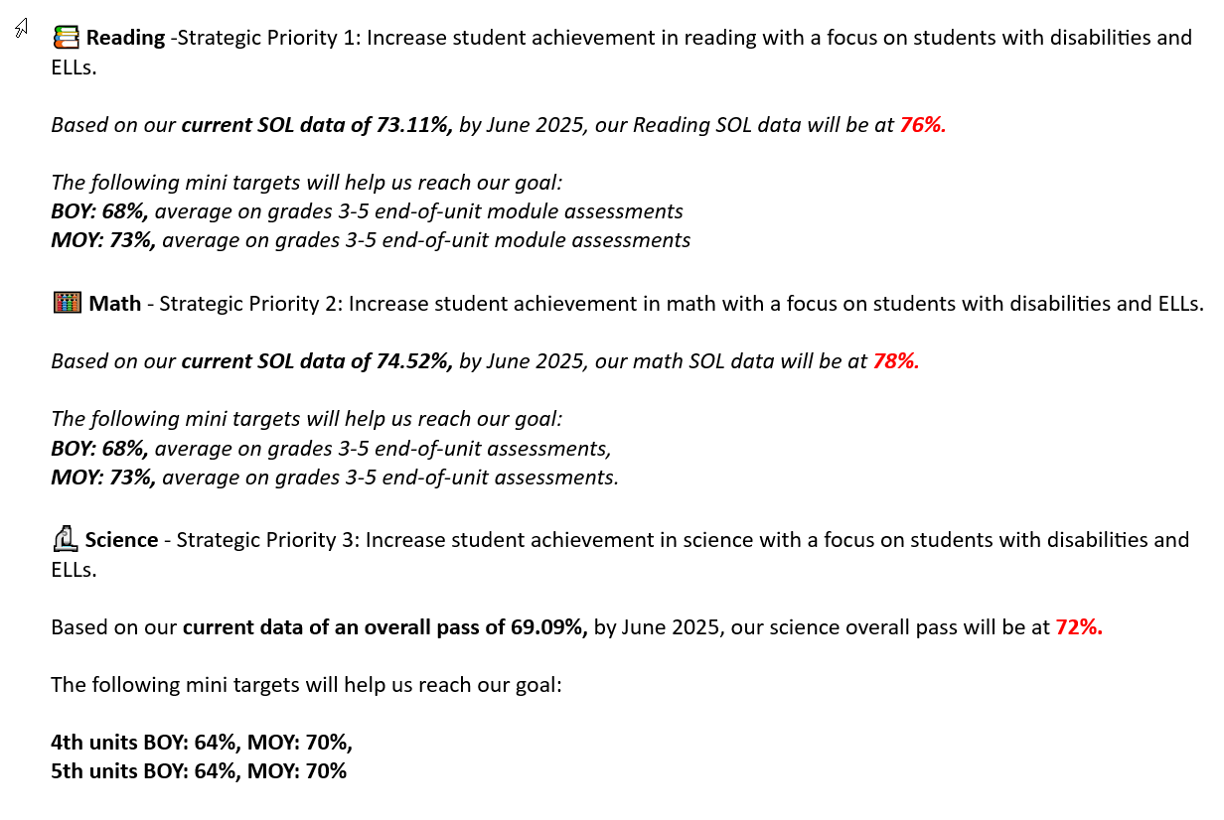
Navigating Q&A sessions

