Slide 1

Advisory Council meeting
December 11, 2024

Slide 2
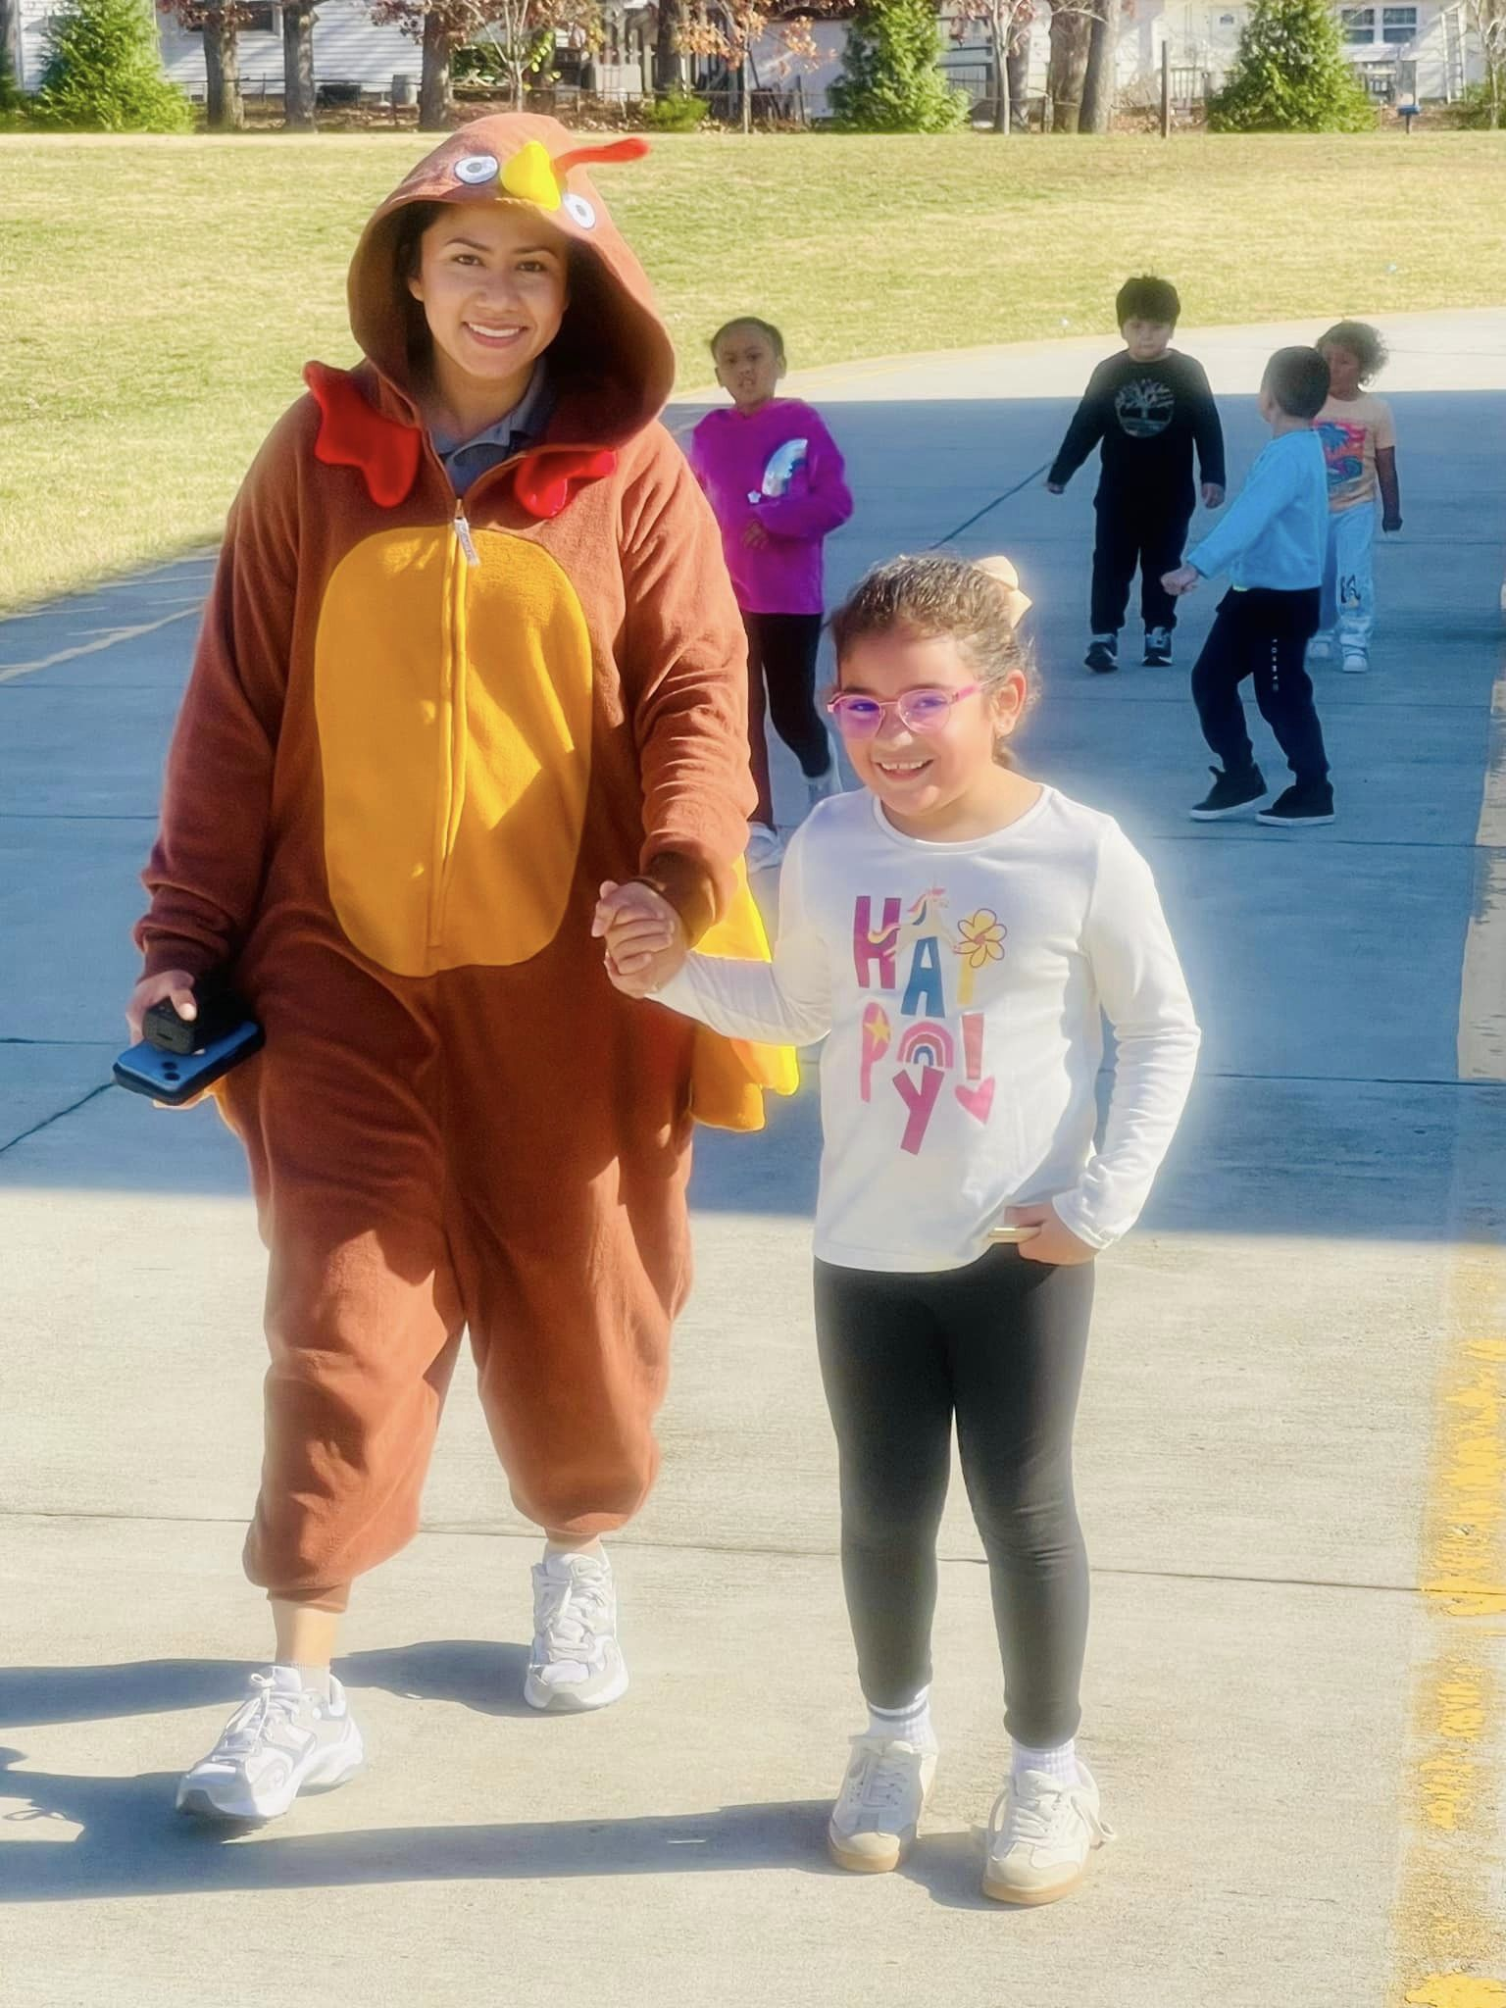
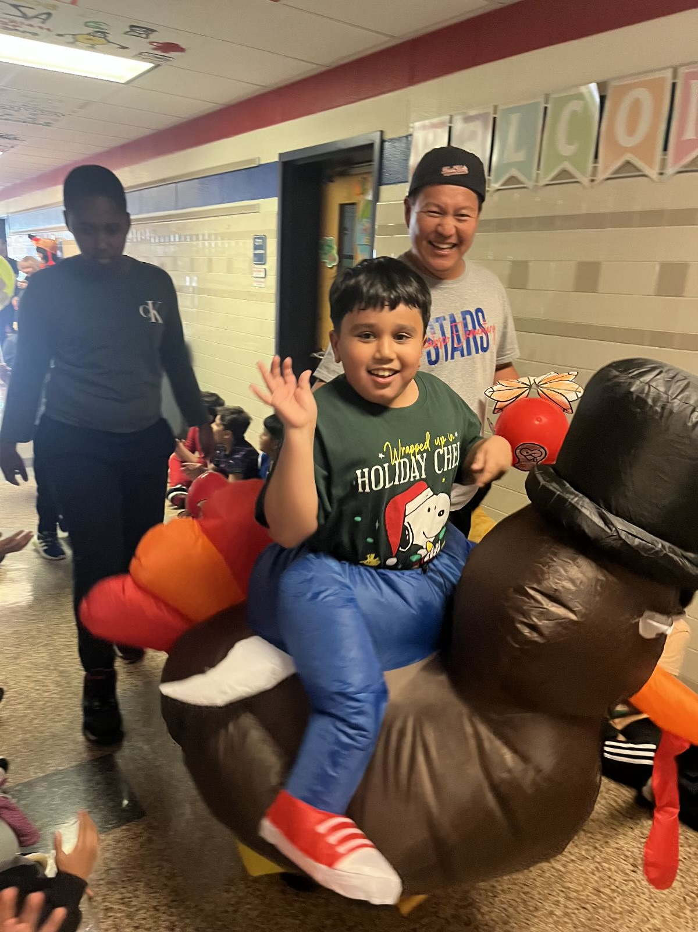
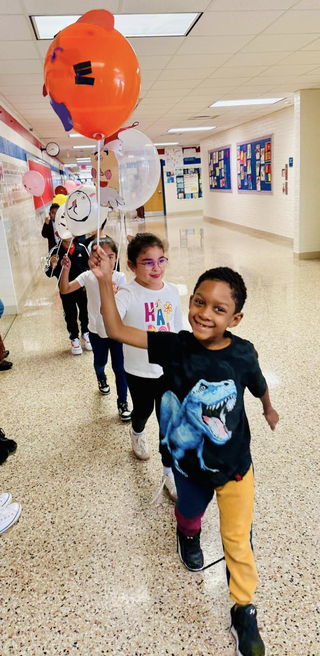
Welcome

Slide 3

BOY Data celebrations
Learning and Achievement for All
Reading
Math
Science
Attendance
Below 10% every month since school starts

Slide 4
Budget update
General Funds to date: $450,773.83
All in VA Tutoring
VALLSS

Slide 5
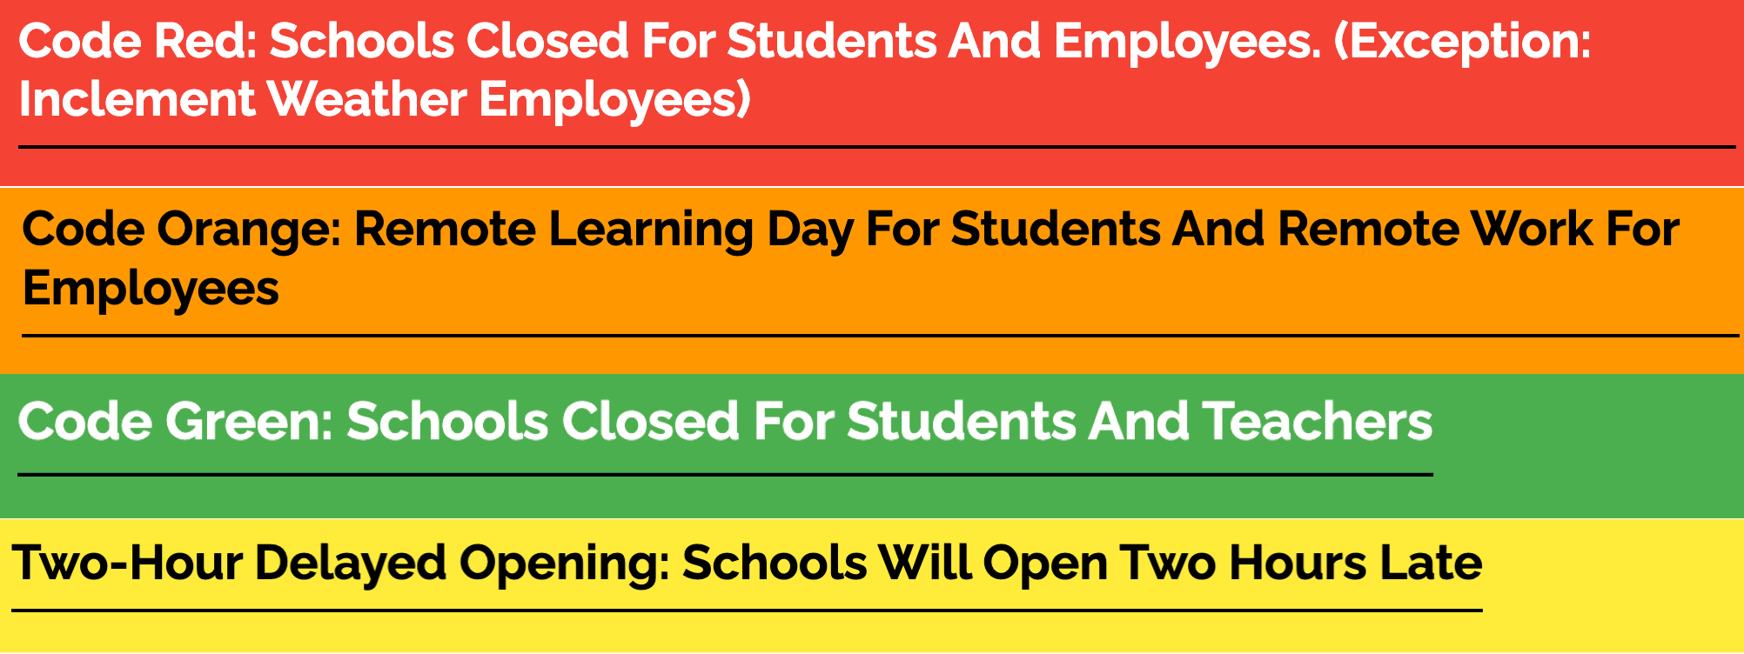
Inclement weather information
https://www.pwcs.edu/about_us/closings/codes/index

Slide 6

What’s next with VALLSS?

Slide 7
Specialty program overview
Here are some key dates for the 2024–2025 specialty program application process for Prince William County Public Schools (PWCS):
Application open: November 1, 2024
Application deadline: February 1, 2025, for all programs except the Center for Fine and Performing Arts, which has a deadline of December 14, 2024
Student acceptances: Announced in mid-to-late February
Seat acceptance deadline: March 5, 2024
The application process is completed through ParentVUE. The Specialty Program Application Process webpage has directions for applying and information about virtual help sessions.
Webpage: https://www.pwcs.edu/academics___programs/advanced_academics___specialty_programs/specialty_programs/elementary_school_programs/index

Slide 8
Gifted education overview
Mrs. Jessica Barrett

